Slide 1

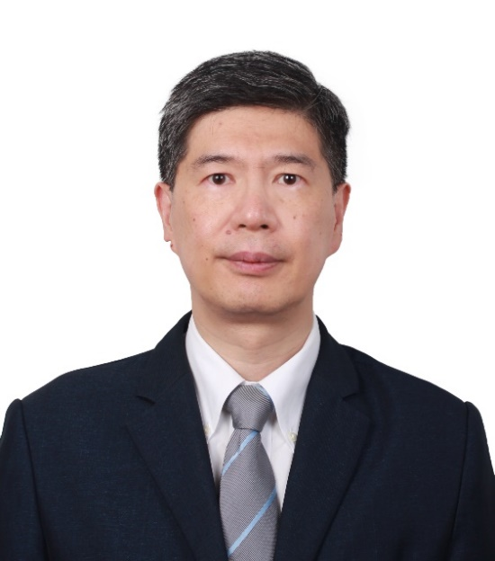
WELCOME TO THE CCFS WEBINAR
September 10, 2020 7:30pm – 9:00pm EST
China-Canada Relations
Distinguished Guest Speaker:
His Excellency CONG Peiwu
Ambassador of the People’s Republic of China

Slide 2
Canada-China Friendship Society (CCFS)
Founded in 1976
Independent, member-financed, non-profit, non-political organization
Objectives:
  To promote Canadian understanding of China
  To promote exchanges between the Canadian and Chinese people
  To strengthen people-to-people ties between the Canadian and Chinese people
www.ccfso.org

Slide 3

YEAR 2020
50th Anniversary of the Establishment of the
Canada-China Diplomatic Relations

Slide 4

China-Canada Relations
Distinguished Guest Speaker:
His Excellency CONG Peiwu
Ambassador of the People’s Republic of China

