Slide 1
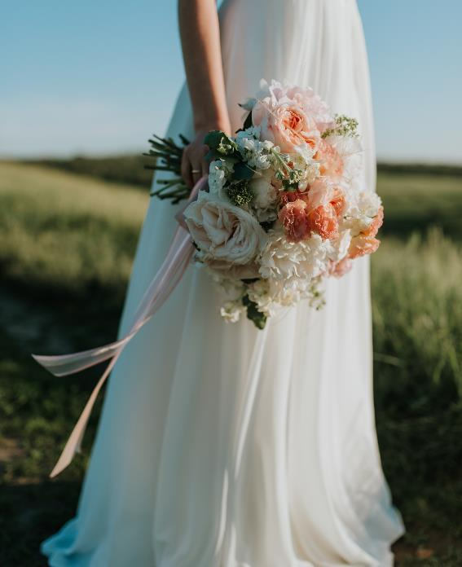
MY WEDDING DAY
Thank you for sharing
01.12.2019
this special day with me

Slide 2
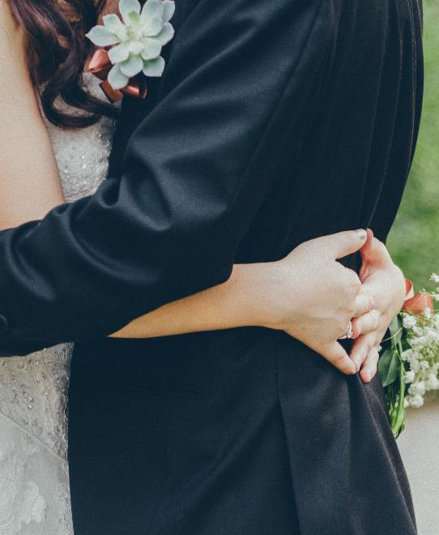
WISHING YOU
LOVE
Jacob + Stephanie

Slide 3

SAVE
THE
DATE
Jacob & Stephanie
01.12.2019
we are getting married

Slide 4
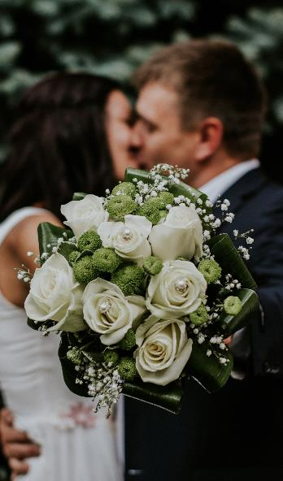

WEDDING
Jacob
+
Stephanie
MEMORIES
01.12.2019

Slide 5

HAPPY
BIRTHDAY
Dear bestie
Hoping your day is as special as you!

Slide 6

TODAY IS YOUR DAY

Slide 7

HAPPY
BIRTHDAY
TO YOU
You are amazing

Slide 8
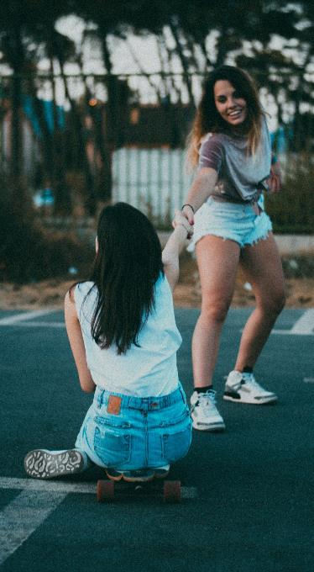

TIME
TO
CELE
BRATE
HAPPY BIRTHDAY

Slide 9



CLASS 2020

Slide 10

CLASS 2020
AN ADVENTURE BEGINS
Bon Voyage!
Dive into the real world with optimism and courage!

Slide 11

CLASS 2020
Wherever you go, go with all your heart

Slide 12

CLASS
2020
Wherever you go, go with all your heart.

Slide 13

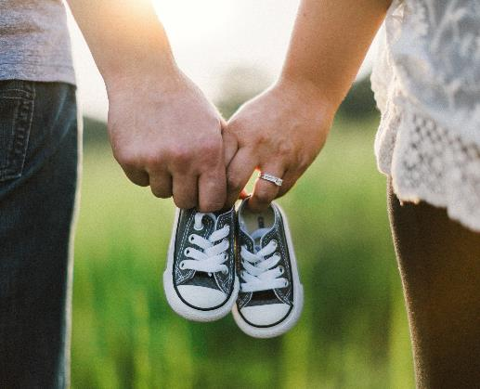
HAPPINESS
WE HAVE SOMETHING TO TELL YOU
IS ON THE WAY

Slide 14

Let me share some great news with you
I SAID YES

Slide 15

ON YOUR ENGAGEMENT.
BEST WISHES

Slide 16
Follow these instructions to update content and save slides as images:
Save Images from Deck
Select the text you want to replace and type your new text. Do this for all slides in deck.
Choose File > Download as > Download as Images. All slides will be downloaded as individual jpg files.
Click Download.

